Slide 1
Biometric Health Check Roadshow
Nardhia Kidd-Walker
Healthy Lifestyle Advisor – Kitts Green

Slide 2
Overview
Free Biometric Screening Offered To All Employees
The health check roadshow is designed to assess the current health of employees on site.
A schedule is designed before hand which ensures all shifts over every department is covered, as well as allocating time for ‘open sessions’ whereby anyone can drop into the Wellness Centre to be assessed.
The screening lasts for 10 minutes per employee.
The employee, OH and healthy lifestyle advisor gets a copy of their results to file.
Statistics and trends of the current health of your employees can then be established.
Depending on the results, future health campaigns and health initiatives can also be established.

Slide 3
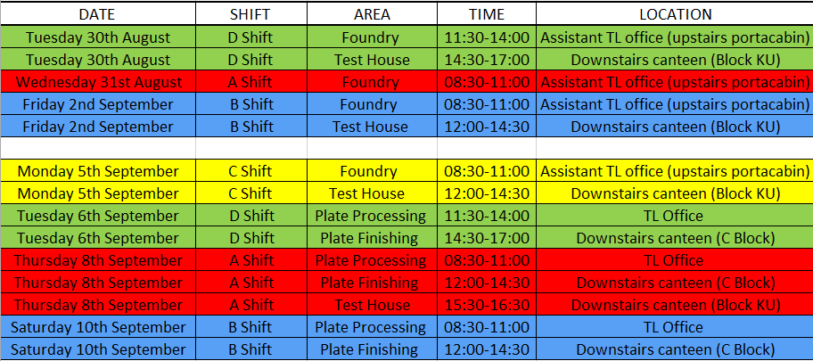
Example of Health Screening Schedule

Slide 4
Benefits
Help’s identify potential health problems at an early stage, allowing interventions to be put into place.
Feedback on which health areas may need more attention for future health campaigns.
Early intervention through individual health profiles and health campaigns leads to: increased productivity, decreased sickness & absence, and increases retention of staff.
Health screening on-site, incredibly convenient for all staff.
Demonstrates to employees that their health and well-being is important to the company.
Builds vital relationships with the employees and the healthy lifestyle advisor/nurses/OH team.

Slide 5
The Screening
What is involved…
Before the health checks, TL for the shift completes a booking sheet allocating 10 minute time slots to employees who wanted a health check.
Within the 10 minute slot, 15 different health markers are checked:
- Height
Weight
BMI
Body Fat Percentage
Hydration
Bone Mineral Mass
Visceral Fats (Internal Fats that surround vital organs)
Metabolic Age
Blood Pressure
Resting Pulse
Blood Glucose (Diabetes)
Full Lipid Panel (Cholesterol) (4 readings – Total Cholesterol, HDL, LDL, Triglycerides)

Slide 6
The Screening cont.…
What is involved…
Each employee given all of the results there and then via the health check assessment form whereby they can take away a copy of their results.
They will also be given any necessary advice or leaflets to help them change some of their results if need be (information on lowering cholesterol etc.).
If their results have come back with 3 or more red results, they will be offered to book a healthy lifestyle advice appointment to seek further support and attention.
Almost 40 percent of employees at Kitts Green participated

Slide 7
Screening Equipment
What’s needed…
Bio-electrical impendence analysis (Tanita or similar): These scales involve sending electrical signals through the soles of the feet and measures body composition via resistance with the water that’s in the body. Whilst there are other forms of apparatus to measure body composition (body fat in particular), these scales are invasive, quick, easy and give results from 9 different markers.
Height Chart
Finger Prick Test: Glucose Machine (Accutrend or similar), Cholesterol Machine which tells full lipid panel (Mission or similar), glucose test strips, lipid panel test strips, cotton buds, lancets (medium and extra strong), plasters, alcohol wipes and non-alcohol sanitising wipes.
Blood Pressure Machine & Various sized cuffs
BMI chart to refer to
Gloves
Sharps Bin
Clinical Waste Bags
Alcohol Gel

Slide 8
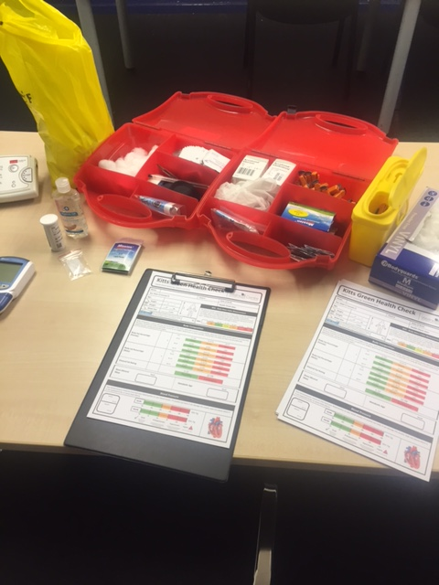
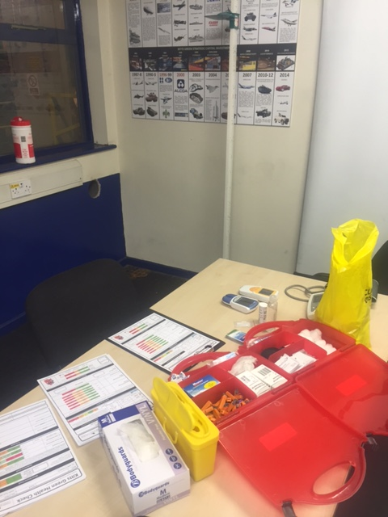
The Set Up

Slide 9
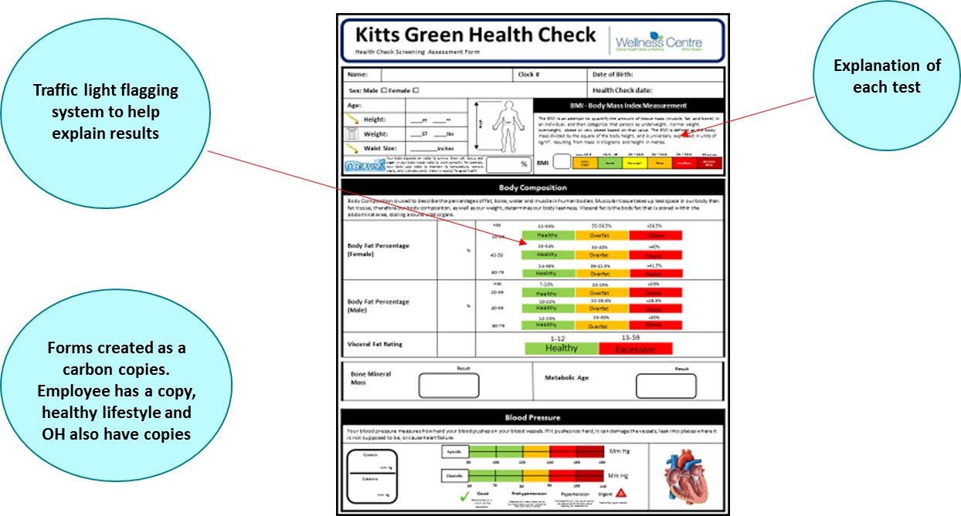
Health Check Assessment Form
Page 1

Slide 10
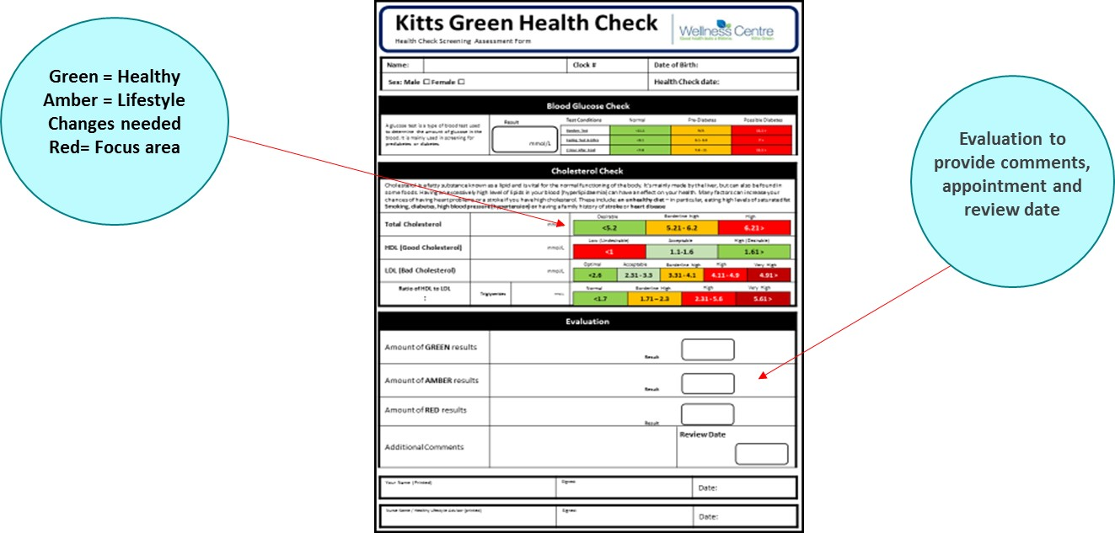
Health Check Assessment Form
Page 2

